Slide 1
Jack Brown's Beer & Burger Joint Sprint 2
Team 2
Alexis Strickland, Khadeem Dublin, Dominant Elting, Ryan McCrary

Slide 2
Preliminary Supplement Specifications
Operational
Performance
Cultural/Political
Security

Slide 3
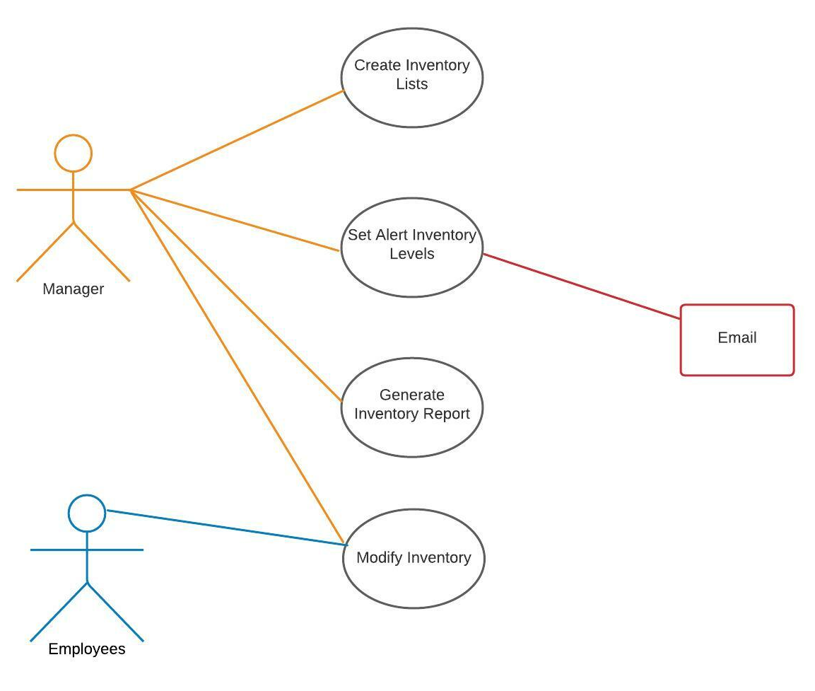
Updated Use Case Diagram

Slide 4

Updated Context Diagram

Slide 5
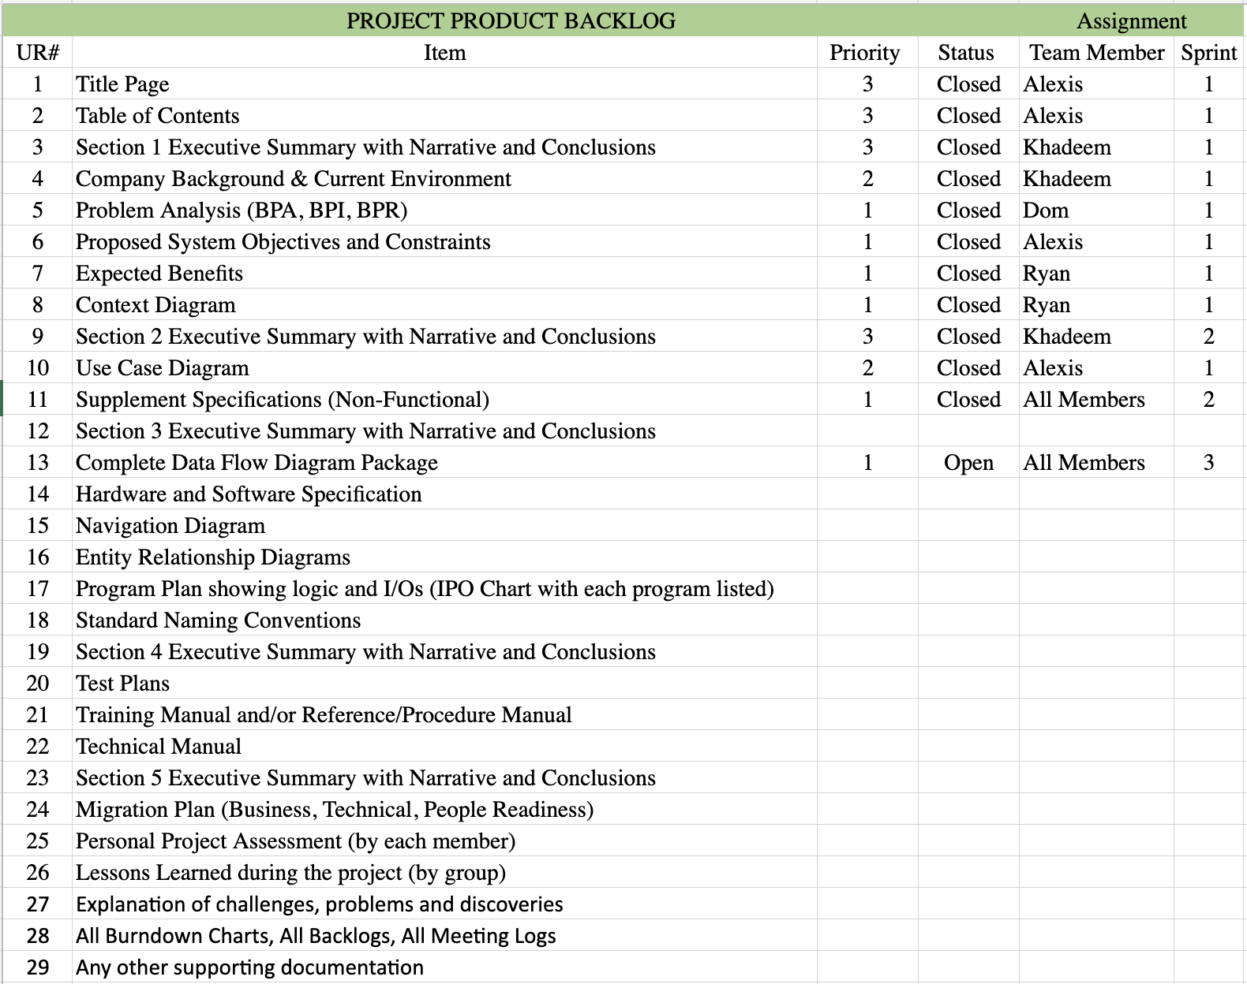
Updated Product Backlog

Slide 6
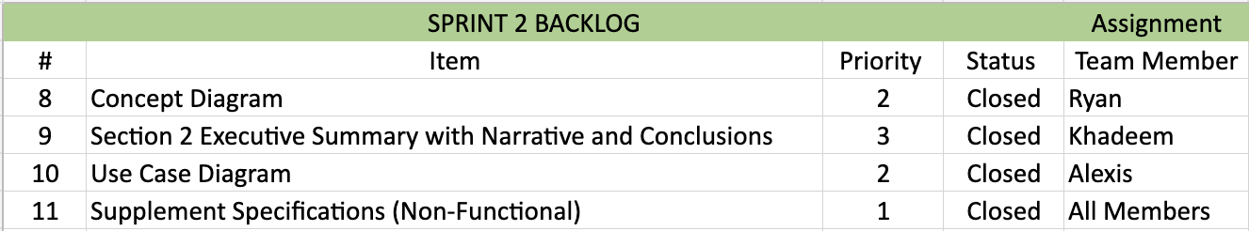
Sprint 2 Backlog

Slide 7
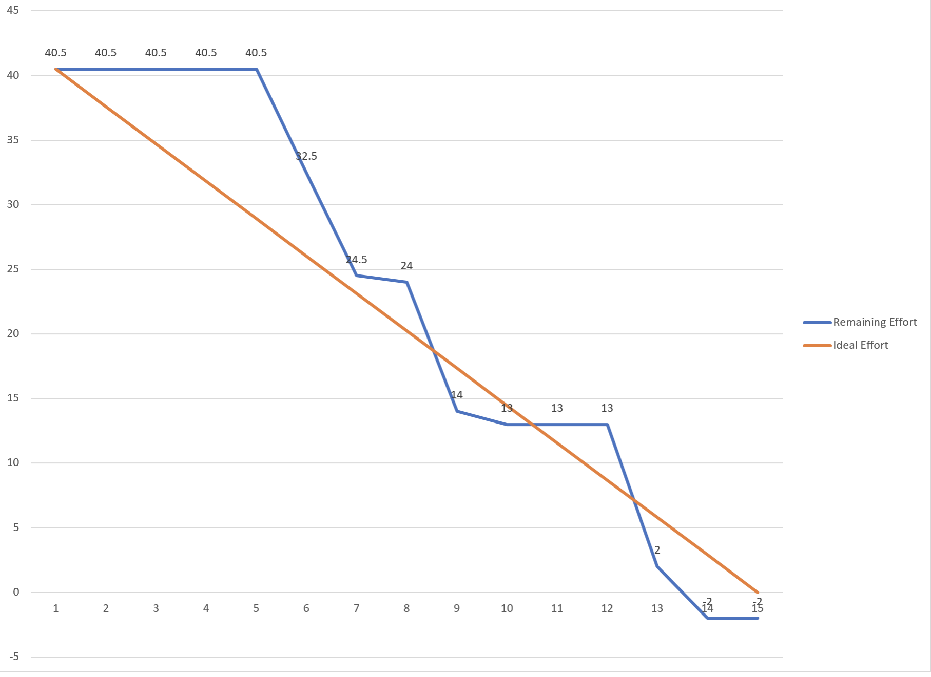
Burndown Chart

Slide 8
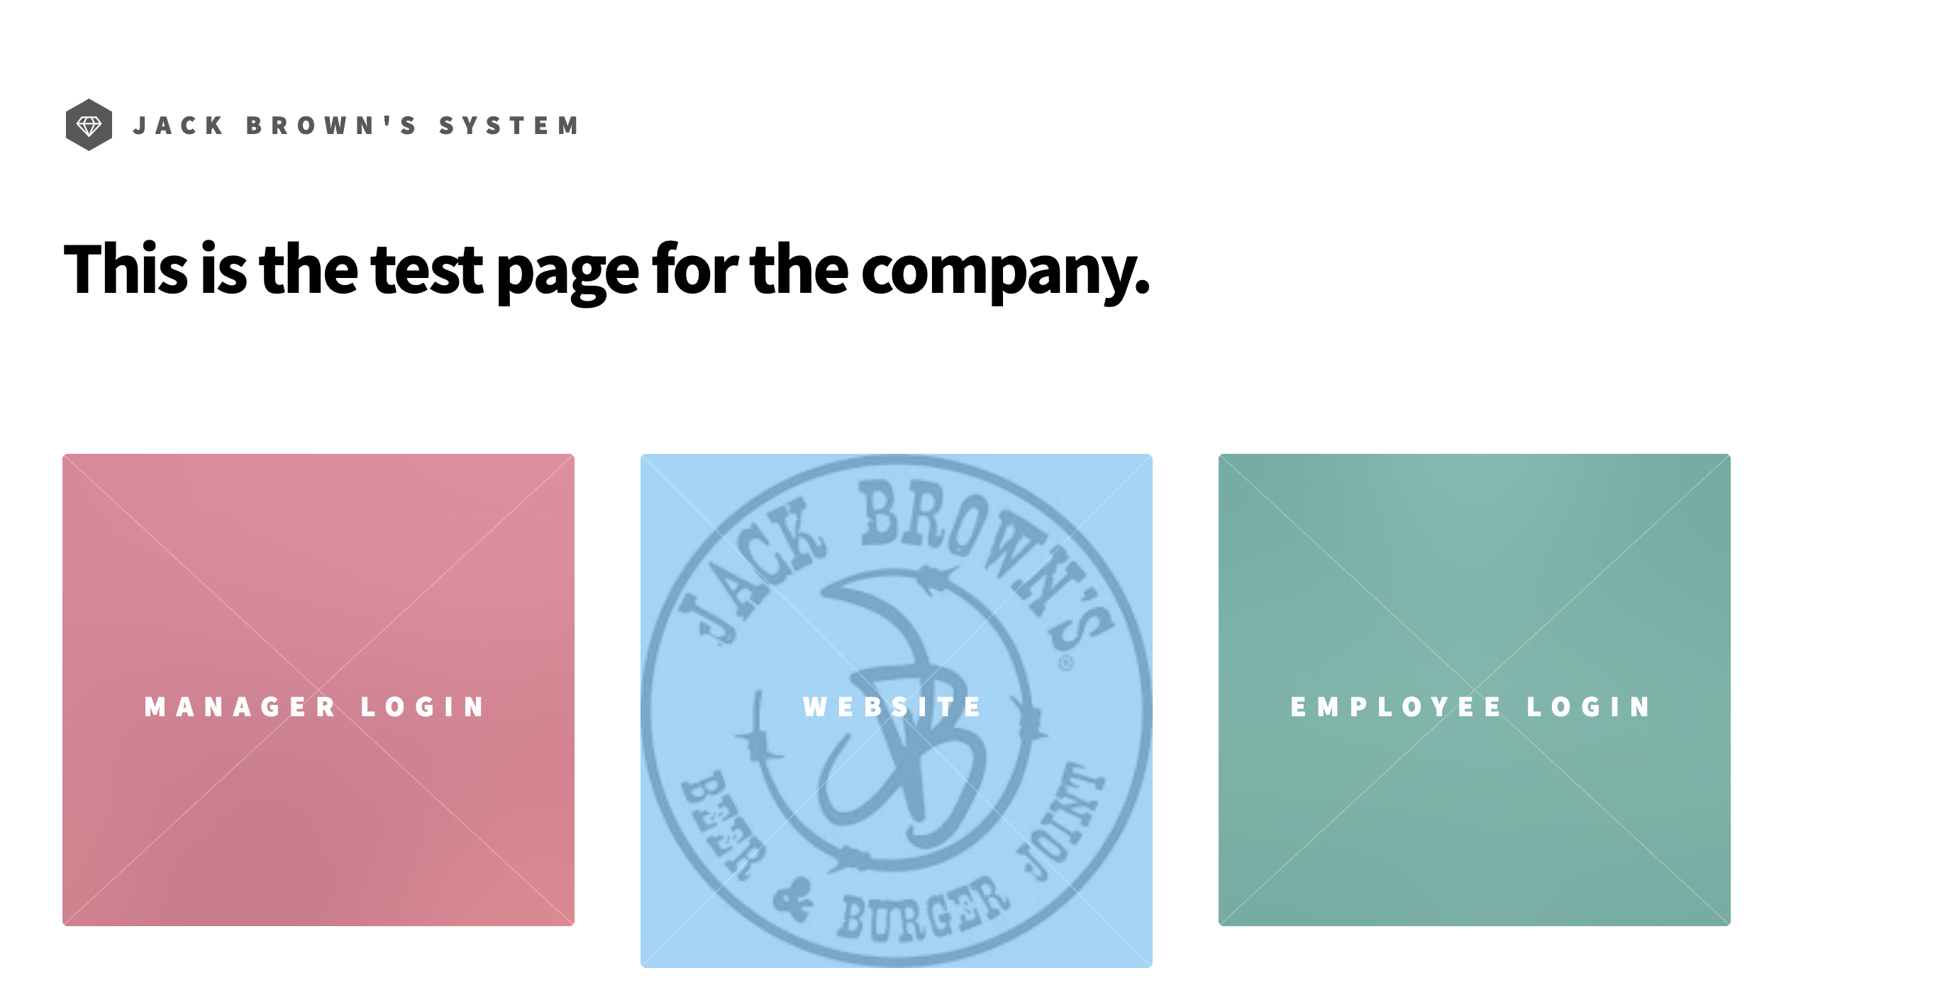
PSPI

Slide 9

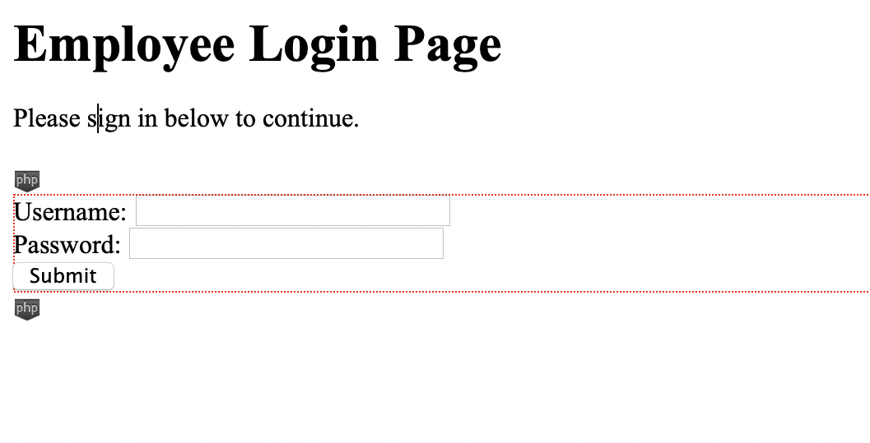
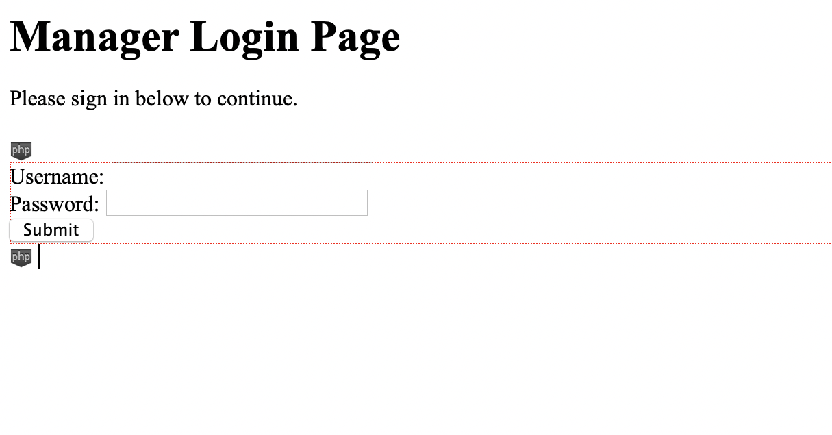
PSPI

